Slide 1
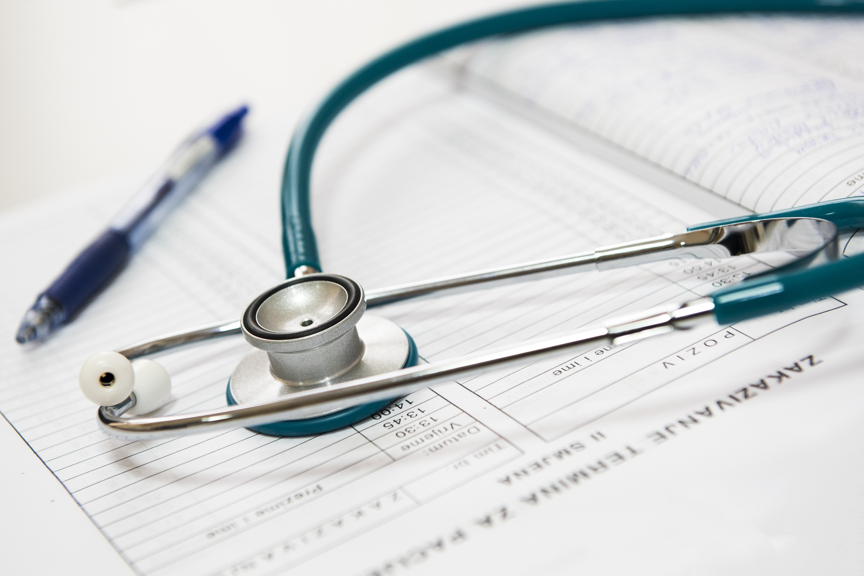
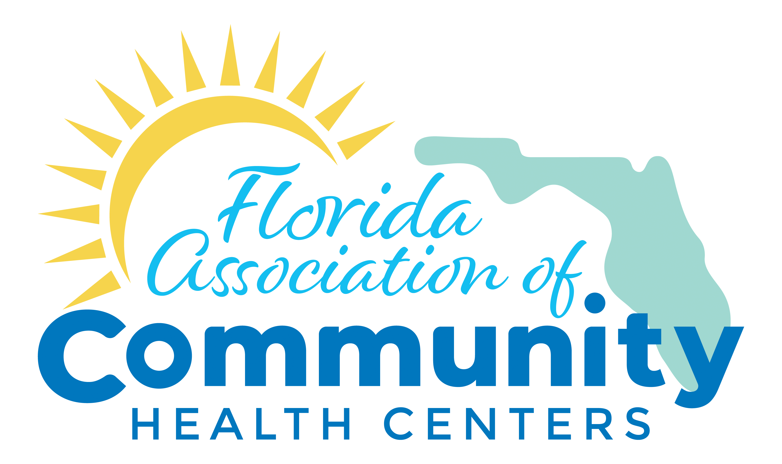
Health center Staff Preparedness 101
The Voice of Primary Care

Slide 2
Welcome and Introduction
So glad you’re here! We’ve developed this awareness-level course for all staff members of Florida’s Community Health Centers.
Recognizing the important role of preparedness for organizations AND individuals, we hope this course provides you with useful and actionable information to increase your preparedness at work and home.
Upon completion, you will be asked to take a short quiz to demonstrate your knowledge and fill out a training evaluation to provide your feedback.

Slide 3
Objectives for This Course
Define Preparedness as part of the Emergency Management cycle.
Emphasize the importance of your participation in preparedness efforts.
Discuss how to promote preparedness at home and in your Health Center.
Provide Quiz to Demonstrate Knowledge & Collect Participant Feedback.

Slide 4
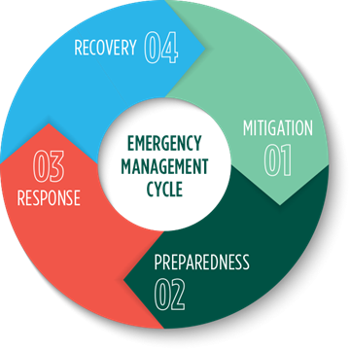
Emergency Management (EM) and the EM Cycle
According to Federal Emergency Management Agency (FEMA),
Emergency management is the managerial function charged with creating the framework within which communities reduce vulnerability to hazards and cope with disasters.
Emergency Management protects communities by coordinating and integrating all activities necessary to build, sustain, and improve the capability to mitigate against, prepare for, respond to, and recover from threatened or actual natural disasters, acts of terrorism, or other man-made disasters.
-
Notes:
Mitigation: Activities designed to reduce the impact of a disaster/emergency
Preparedness: Activities, programs, and systems that exist prior to an emergency to support and enhance response to an emergency or disaster.
Response: actions to address the immediate and short-term effects at onset of an emergency or disaster
Recovery: activities and programs beyond the initial crisis period of an emergency or disaster designed to return all systems to normal status, here it is possible to update plans and implement corrective actions.

Slide 5
Preparedness Definitions…
Preparedness within the field of emergency management can best be defined as a state of readiness to respond to a disaster, crisis or any other type of emergency situation.
Personal Preparedness refers to the steps you take to make sure you are safe before, during and after an emergency or natural disaster.
Healthcare System Preparedness ensures that there is capacity and capability for provision of critical public health and medical services in order to reduce the potential for adverse health outcomes during an event.

Slide 6

Why Personal Preparedness?
Having a personal and family preparedness plan increases your chances of staying safe and helps you to be resilient during and after a disaster.
To ‘live with resilience’ means that no matter what obstacles you will face, you will survive and get back to normal. A well thought out plan also enables you and your family to be as comfortable as possible during and after a disaster.
As a Health Center staff member, you will want to be assured that your family is taken care of before you answer your Health Center’s call to report to work. Your family plan will help you at home and at work and does not have to be long or complex to be effective.
The NCDP Model for Disaster Preparedness

Slide 7
Food for Thought…
Know your Risks.
Involve your Community.
Communicate
Protect yourself and your family.
Assure food and water.
Live with Resilience
Being personally prepared is more than completing a checklist or assembling a kit. Being prepared requires planning based on thinking–thinking about the risks you face, the needs of your household and the way you and your family live and work day-to-day.
It also means thinking about how you want to live during the days immediately following a disaster when government and community services may not be available, for days or weeks.
Consider These Scenarios: Stay, Go, or Shelter in Place? Each of these situations demands decisions and requires emergency supplies. It is best to know your risks now and plan proactively according to your household needs.
Notes:
What risks do you face? are the risks for you and your family where you live and where you go to school or work? These can be very different places and different risks. How will you communicate if family members are separated?
Who makes up your household? Do you have infants, nursing mothers, children, elderly, anyone with special health care needs or mobility or developmental challenges? These are important things to think about and understand how each disaster may impact the family. You will need to pull together special items, vital medications and sometimes, equipment; this will take some thoughtful planning.
Stay or go? To stay, means you will “ride out” the storm or emergency at home or go to a friend or family member’s home and “hunker down”. To go means you may have to evacuate to an emergency shelter if emergency officials determine that your area is at risk for more severe damage or you may leave town entirely. There is a third possibility, one we don’t often think about: if you are at work or school or on the road and a disaster strikes and you have to shelter-in-place, meaning you must stay wherever you are until it is safe to leave. Each of these situations demands decisions and requires emergency supplies. It is best to know your risks now and plan according to your household needs before a disaster strikes.

Slide 8
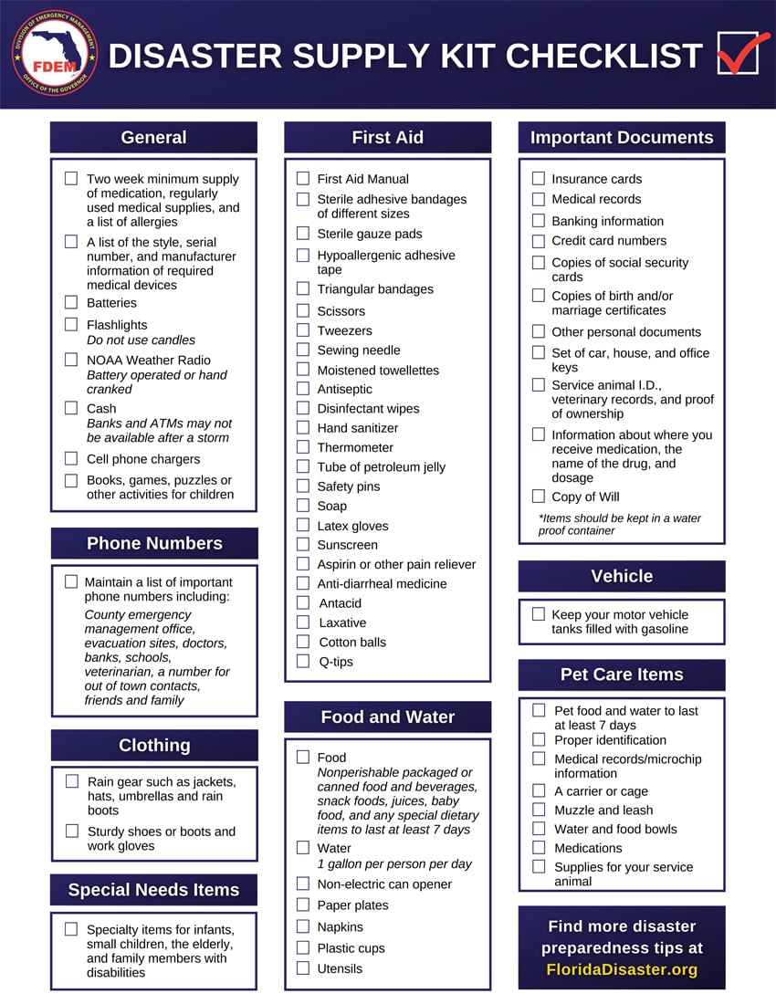
Resources for Personal Preparedness
Ready. gov
Center for Disease Prevention and Control (CDC)
Florida Division of Emergency Management
Alert Florida- sign up for local alerts
Volunteer Florida & Community Response Teams
County Emergency Management Office, Health Department, School System, and Community-Based Organization or Neighborhood Association websites and social media pages
Notes:
This slide refers to federal, state, and local preparedness resources= these links are also found in your course materials. Awareness and utilization of these resources, especially at the local level are an important component of maintaining personal preparedness.

Slide 9
Let’s Switch Gears!
Health Center Preparedness
Preparedness at Home

Slide 10
Why Health Center Preparedness?
Health centers play a critical role in providing continuity of care to support communities during and after natural or man-made emergencies.
Emergencies also affect health center operations which is why preparedness and emergency management planning is essential.
Health Center Preparedness and related staff training are also required for all Medicare/Medicaid Service Providers including FQHCs.

Slide 11
Health Center Preparedness Requirements
Training and Testing
Communication Planning
Policies and Procedures (based on risks)
Risk Assessment and Emergency Planning

Slide 12
Preparedness: Your Participation is Essential
We cannot prepare passively or reactively. We must think and ACT ahead of time in order to safeguard ourselves, our loved ones, and our communities.
Promoting a culture of preparedness starts with YOU!
Prepare personally, be vigilant at home and work, communicate regularly, stay informed, and participate in trainings, drills, and exercises (like this one!)

Slide 13
Next Steps for Health Center Staff
Assess your personal risks, develop or update family plans, identify communication methods, and opportunities to engage with your community.
Review/DISCUSS your role(s) in the Health Center’s emergency response PLANS.
Update/verify contact information regularly and you know how to communicate with your health center’s key personnel.
Participate in training and exercises as planned by your health center’s emergency management team.

Slide 14

Gianna Van Winkle
Director of Emergency Preparedness Programs
Email: gianna@fachc.org
Phone: 850-591-1832
Please complete the quiz and training evaluation for the option to print your certificate of participation.
Your feedback is greatly appreciated!

